Slide 1



Entangled state preparation via cluster states on quantum computers with <qo|op> software
<qo|op>
Vu Tuan Hai (NAIST, Japan)
Jesus Urbaneja (Tohoku, Japan)
Binho Le (Tohoku, Japan)
QSW 2025, Jul. 7-13, Helsinki, Finland

Slide 2
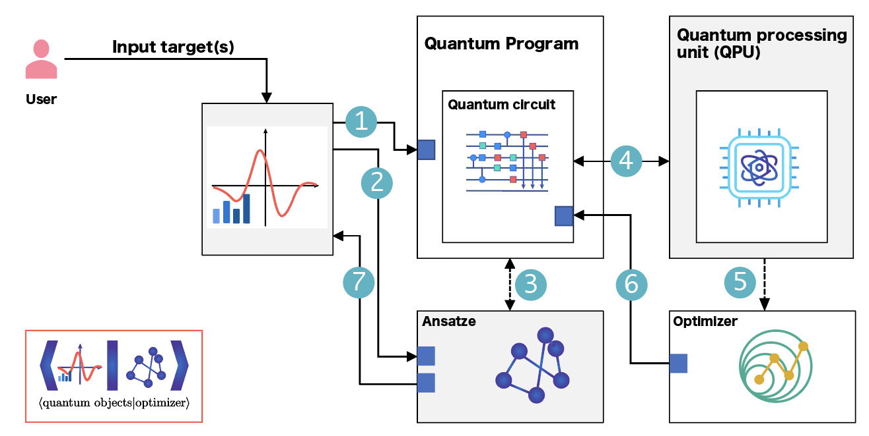
Outline
VQA and Quantum compilation
⟨qo|op⟩ software
Entangled state preparation

Slide 3
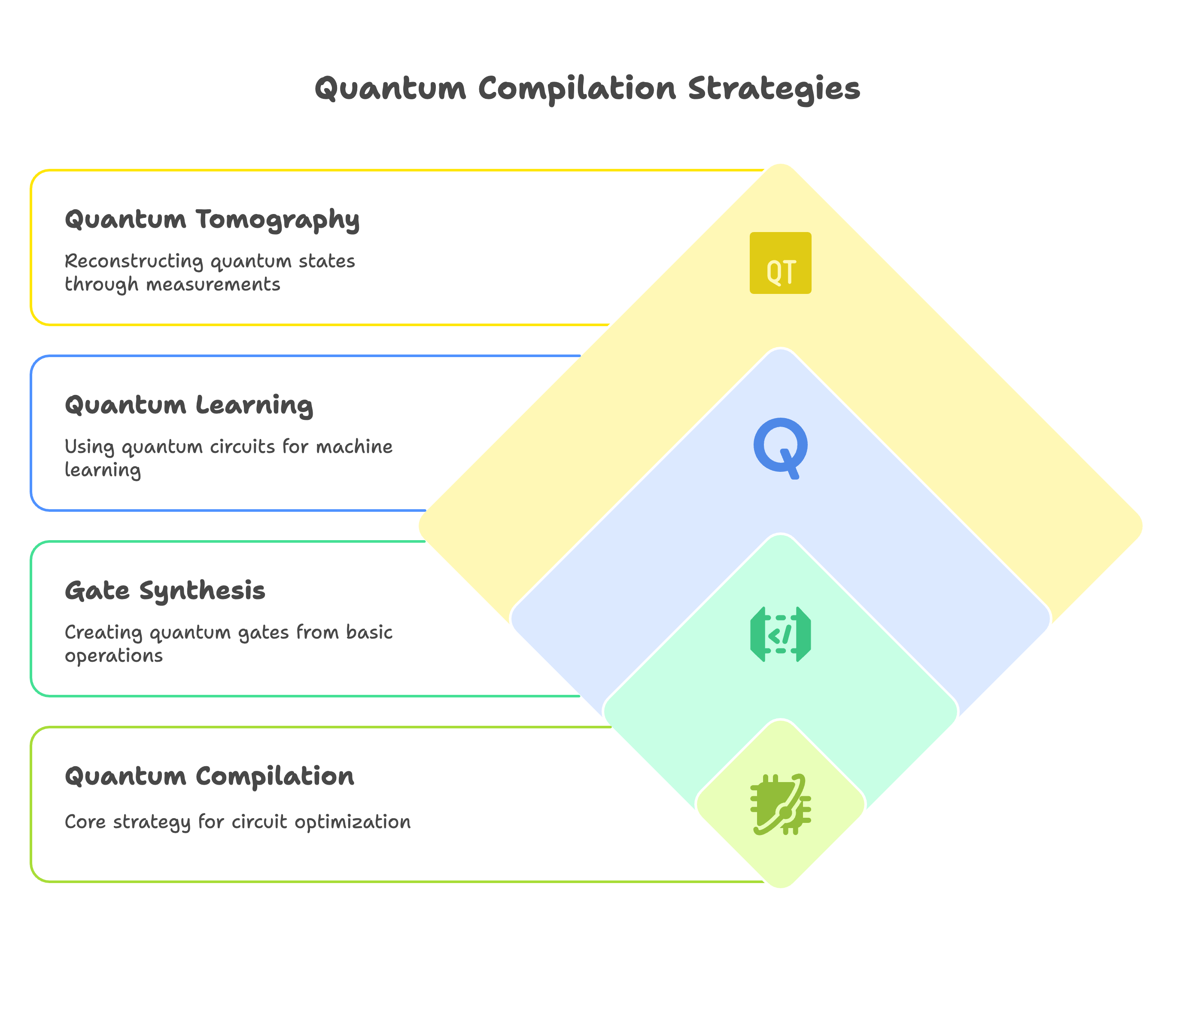
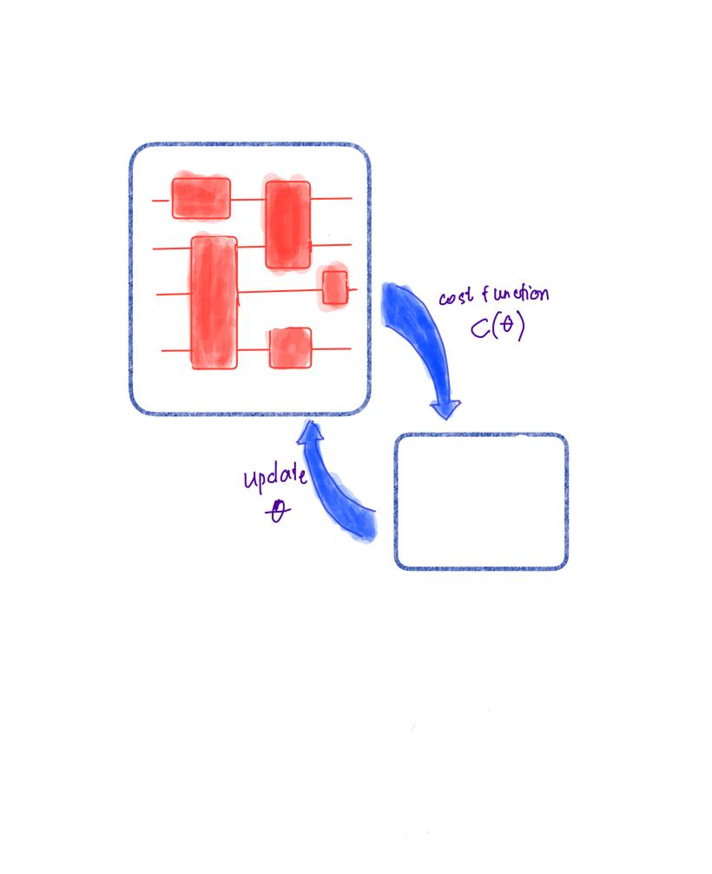
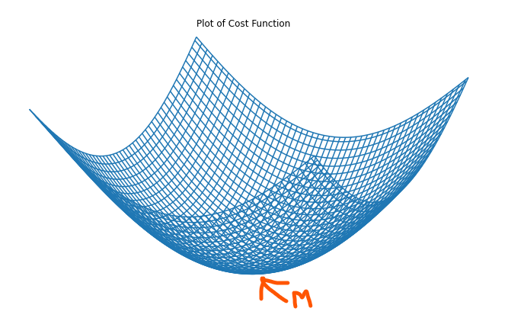
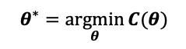
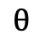
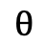
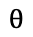
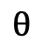
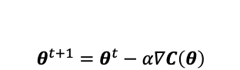
VQA and Quantum Compilation
Variational Quantum Algorithms (VQAs)
Scientific Reports 13, 3750 (2023)
Quantum Circuits
Classical Optimization
arXiv.2504.14958 (2025)
Quantum
$$θ$$
$$θ$$
$$θ$$
$$θ$$
$$θ^{∗}=\underset{θ}{argmin}{C(θ)}$$
$$θ$$
$$θ^{t+1}=θ^{t}−α∇C\left(θ\right)$$
Classical
Machine Learning: Science and Technology 5, 045057 (2024)

Slide 4
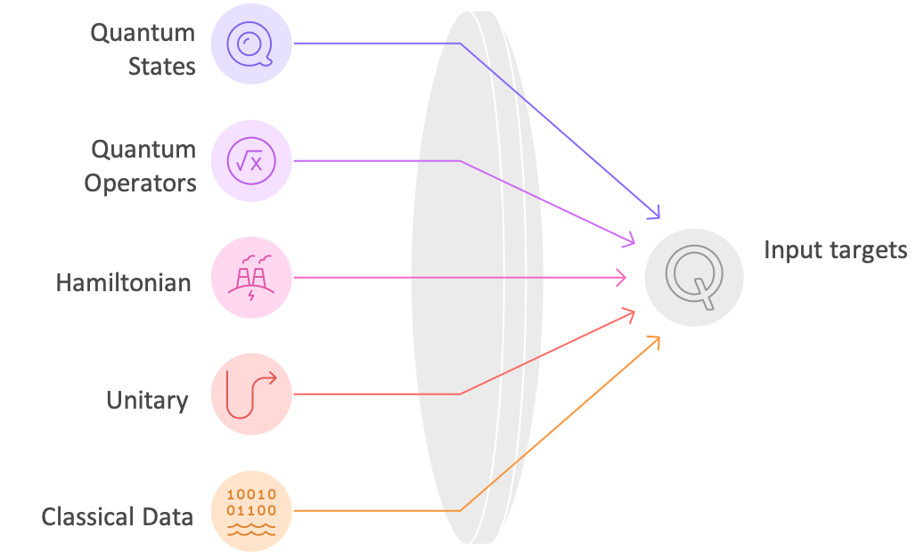
Overview of ⟨qo|op⟩
SoftwareX 26, 101726 (2024)

Slide 5
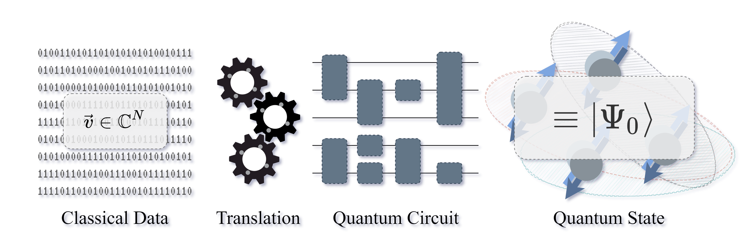
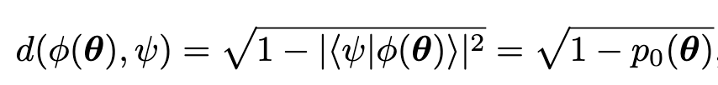


Quantum state preparation
A quantum state can be decomposed into U|0>
The ansatz V is combination of trainable gates
U
$$≡$$
In <qo|op>, the full circuit look likes:
U†

Slide 6
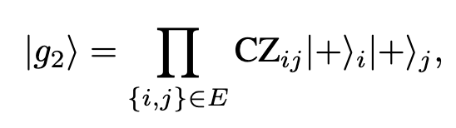
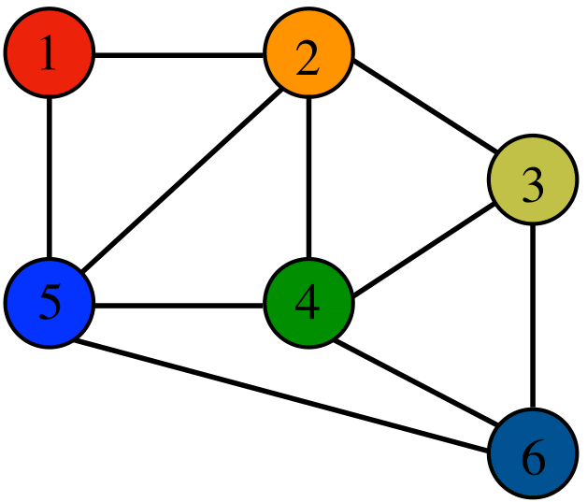
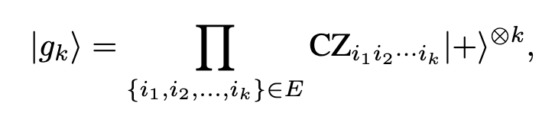
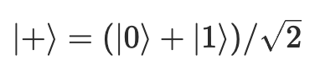
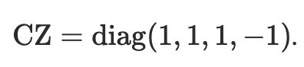
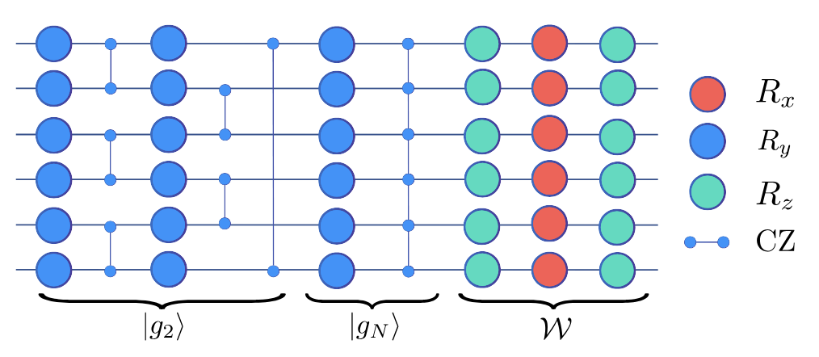
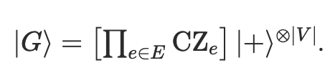
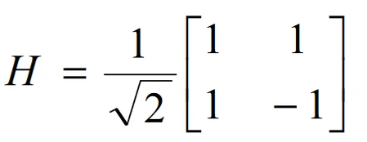
Cluster-based ansatze
Vertex
Edge
Hyper graph
H
1
CZ
2
H
(separable state)
(entangled state)

Slide 7
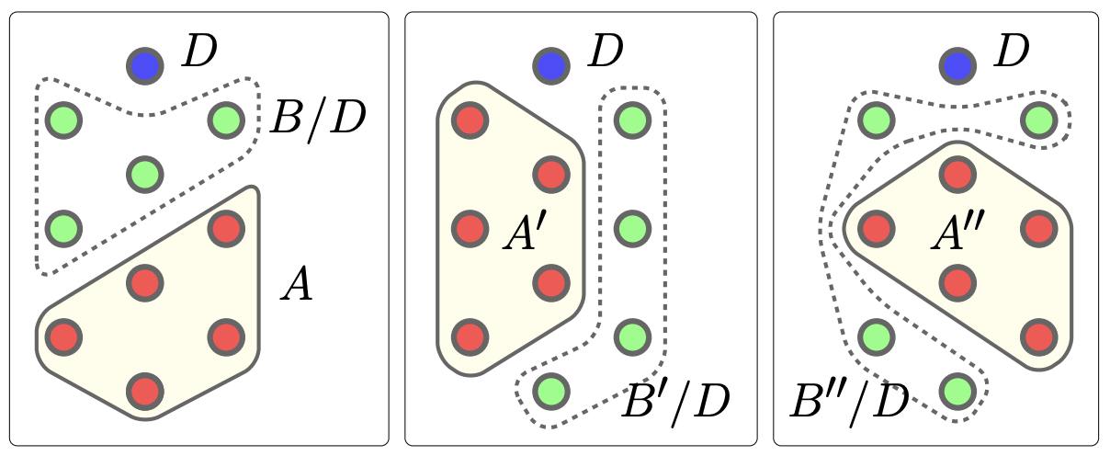
Absolutely Maximally Entangled States (AME)
[Helwig et al. PRA 86 (2012)]

Slide 8
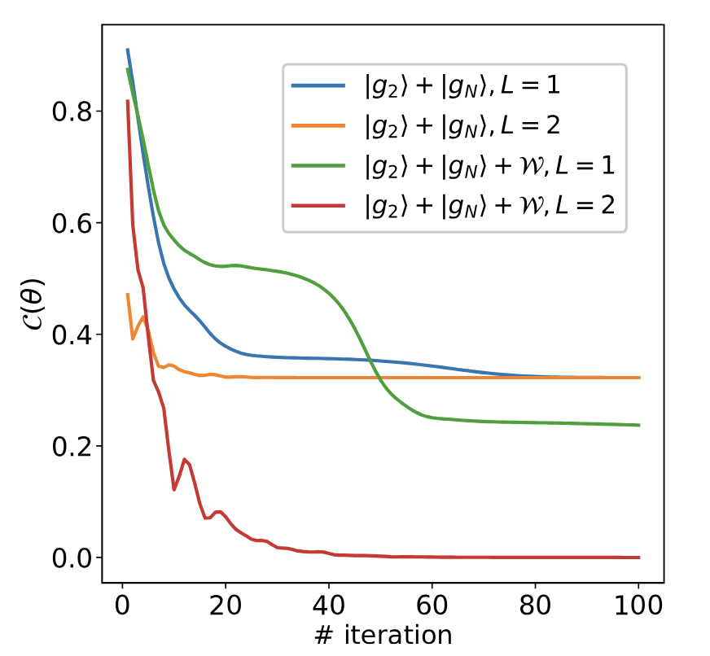
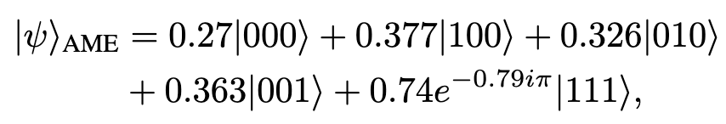
Preparation of AME states
In <qo|op>
U†

Slide 9
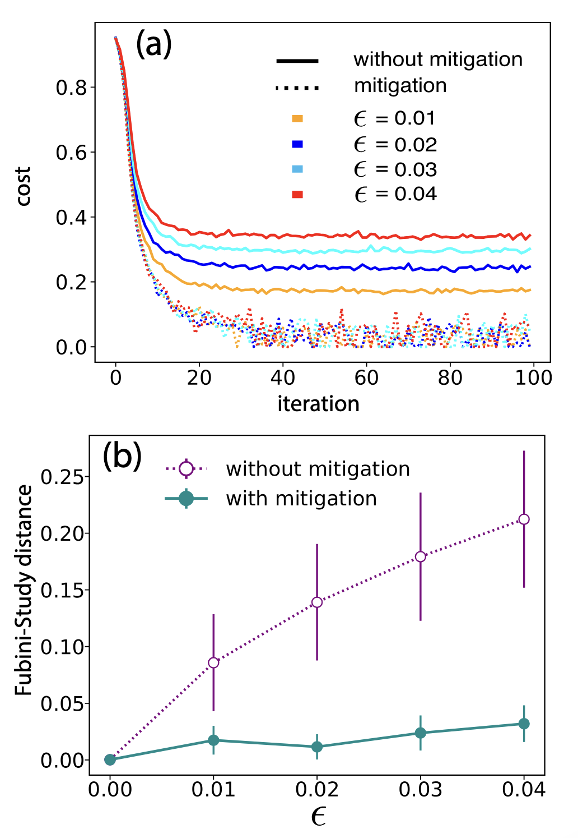
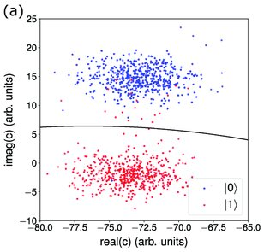
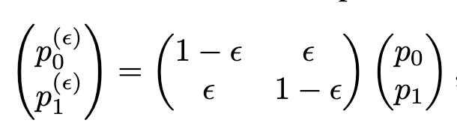
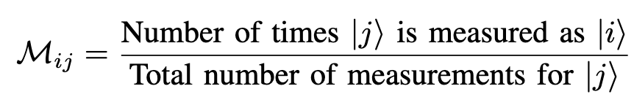
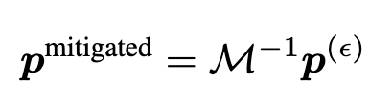
Noisy and Error correction
PhysRevResearch.5.033060
Causes of Readout Errors
Crosstalk
Amplifier noise
Relaxation during measurement
Detector inefficiency
ϵ : error rate
True prob.
Readout prob.

Slide 10
Summary
⟨qo|op⟩ is a versatile software for quantum compilation algorithms.
It has wide applications, from quantum gate validation to quantum dynamics simulation.
⟨qo|op⟩ is applied to entangled state preparation.
It also allows for noise mitigation.

Slide 11
Thank you very much for your attention!

